Slide 1
A New Architecture for
Choreographic Programming Languages
Mako Bates
a dissertation in Computer Science
College of Engineering and Mathematical Sciences, UVM
Feb 27th 2025
mako.bates@uvm.edu

Slide 2
Writing concurrent systems manually is hard
Use multi-party programming!
-- Client
main = for r in requests do
send r to validator
result <- recv from processor
case result of
Good(val) -> save(val)
Bad(err) -> log(err)
What do those programs do?
How might the system fail?
Is bandwidth used efficiently?
-- Validator
main = do
r <- recv from client
if valid(r):
send r to processor
main
-- Processor
main = do
validated <- recv from
validator
result <- handle(validated)
send result to client
main
Write one program that describes everyone’s actions.
Let the compiler split out the implementations of the different participants.
Notes:
Writing a system of concurrently executing… is hard.
.
We’ve got three small programs up here;
What do they do?
How might they fail?
Are they efficient?
.
We can make reasoning about these systems easier
By writing one program that says what everyone does.
That’s multi-party programming.

Slide 3
Choreographic Programming (CP): safe & easy multi-party programming
One “third person omniscient” thread describes all the actions explicitly.
Choreographic programming (CP) is safe: no deadlocks or (in-band) miss-communications.
Choreographies are easy to write and reason about!
Endpoint Projection
(EPP)
_ <- send(Bob, x)
y <- (Alice, x) ~> Bob
y :: Located Bob Int
y <- recv(Alice)
Notes:
The only kind of mp programming we’re talking about today is CP.
.
In CP, you write your protocol from a 3’rd person omniscient perspective, exactly like you’re telling a Alice&Bob story.
- No “send” or “receive” operations, those are two sides of the same coin, and we call that one operation “comm” for “communicate”. (~>)
- During compilation we do endpoint projection (EPP), which means…
- We get some safety guarentees: no deadlocks. Never parse a message payload as being from the wrong part of the program.
- It’s easy.

Slide 4
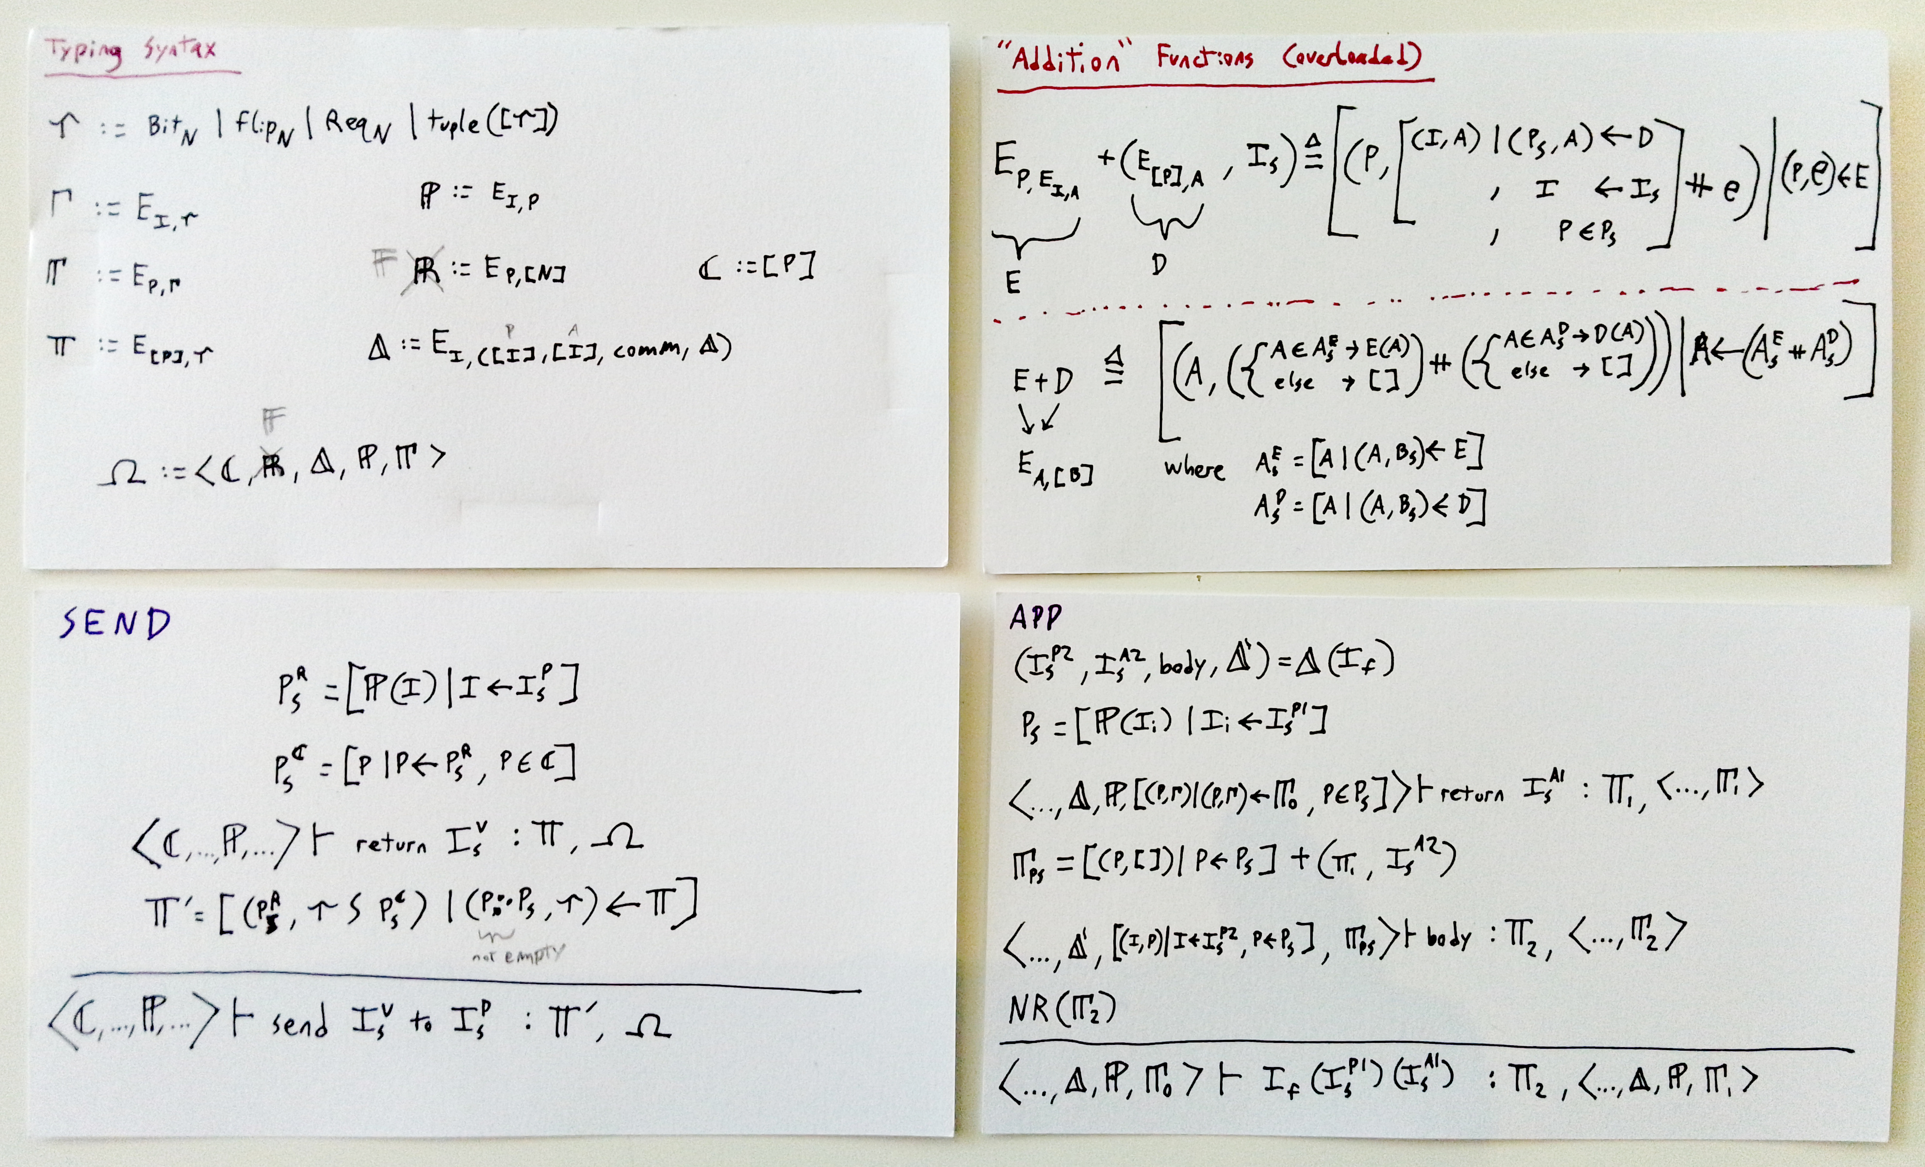
Naive attempts: Spring 2022?

Slide 5
The .CHO probabilistic choreographic language
Choreographic
Higher-order
Location polymorphic
No control-flow branching!
MACRO and_gmw(P1(x2, y2), P2(x1, y1)) AS
out2 = FLIP @P2
g1_s2_00 = out2 + ((x1 + 0) ˆ (y1 + 0))
g1_s2_01 = out2 + ((x1 + 0) ˆ (y1 + 1))
g1_s2_10 = out2 + ((x1 + 1) ˆ (y1 + 0))
g1_s2_11 = out2 + ((x1 + 1) ˆ (y1 + 1))
out1 = OBLIVIOUSLY [[g1_s2_00,
g1_s2_01]?y2,
[g1_s2_10,
g1_s2_11]?y2
]?x2 FOR P1
ENDMACRO
Mako Bates and Joe Near. 2024. DT-SIM: Property-Based Testing for MPC Security. Submitted paper under review.

Slide 6
λC mirrors the syntax of Chorλ
Chorλ ::= x
| λ x:T . M
| Inl V | … | snd
| Pair V V | ()@P
| comP,P
| f(P⁺) | E E
| case E of Inl x ⇒ E; Inr x ⇒ E
| selectP,P l E
λC ::= x
| (λ x:T . M)@P⁺
| Inl V | … | sndP+ | lookupP+^{n}
| Pair V V | ()@P⁺ | (V, ...)
| comP,P+
| E E
| caseP+ E of Inl x ⇒ E; Inr x ⇒ E

Slide 7
λC introduced Multiply-Located Values.
EPPP1(V@P2) :=
EPPP1(V@PS) :=
P1=P2 V
P1≠P2 ⊥
A multiply-located value (MLV) is just like a traditional located value, except the ownership meta-data is a list or set of parties instead of just one party.
P1∈PS V
P1∉PS ⊥
Notes:
Skipping why.
Conclave lifts its body from a choreography with one census to a choreography with a super-census,
And wrapps the return value as an MLV.
.
A located value is just a value or variable annotated with it’s owner; during endpoint projection everyone else uses a placeholder.
.
An MLV works exactly like a traditional located value,
But it has a list of owners.
.
Critical to the use of MLVs: There’s only one value! All the owners know and agree on that one value.

Slide 8
The conclaves strategy for KoC management.
-- Send a request to a KVS server that maintains a backup.
kvs :: Located '[Client] Request
-> Choreo '[Client, Server, Backup] (Located '[Client] Response)
kvs request = do
request' <- (client, request) ~> server;
response <- conclave [server, backup] do {
request'' <- broadcast (server, request');
case request'' of
Put key value -> do {
_result <- locally backup (save key value);
_success <- (backup, unit) ~> server;
locally server (save key value);
}
Get key -> locally server (lookup key);
}
(server, response) ~> client;
3
5
6
7
8
Notes:
Here’s how to use conclaves and broadcast to do efficient KOC.
.
Ln3: Our census is “client, server, backup”.
Ln5: client sends a request. Note sqiggle arrow.
Ln8: we want to branch on the request.
Only the server and the backup actually branch, so:
Ln6: enter a conclave. In this DO block, census is just “server and backup”.
Ln7: broadcast doesn’t go to client, because they’re not in the census.
Now we can branch on request-double-prime, because client will skip all of this.
.
But what do we actually get out of a conclave?
What’s the type of “response” on ln6?
First version of ChoRus simply required conclaves to return located values, but the details were buggy and we can do better.

Slide 9
MLVs make KoC recyclable.
x owned by
Alice
Conclave
to Alice & Bob.
Alice broadcasts x
if x....;
return y
Carroll’s
just hanging out.
MLV
Conclave
to Alice & Bob.
if y....;
Notes:
We get back the efficient and explicit communication using conclaves and MLVs.
It’s as simple as it looks.

Slide 10
Select-&-Merge Conclaves-&-MLVs
Manually merge homologous behavior when writing programs.
select “desugars” to
share-&-branch.*
Multicast and MLVs “desugar”
to select and Distributed Choice Types (tuples).
* Formal
demonstration is
future work.

Slide 11
MultiChor synthesizes the ideas
HasChor
λC
MultiChor
Experience
ChoRus
Monadic effects
& handlers
Multiply located
values
Conclave & broadcast
operators
Multiply located
values
Census
Polymorphism

Slide 12
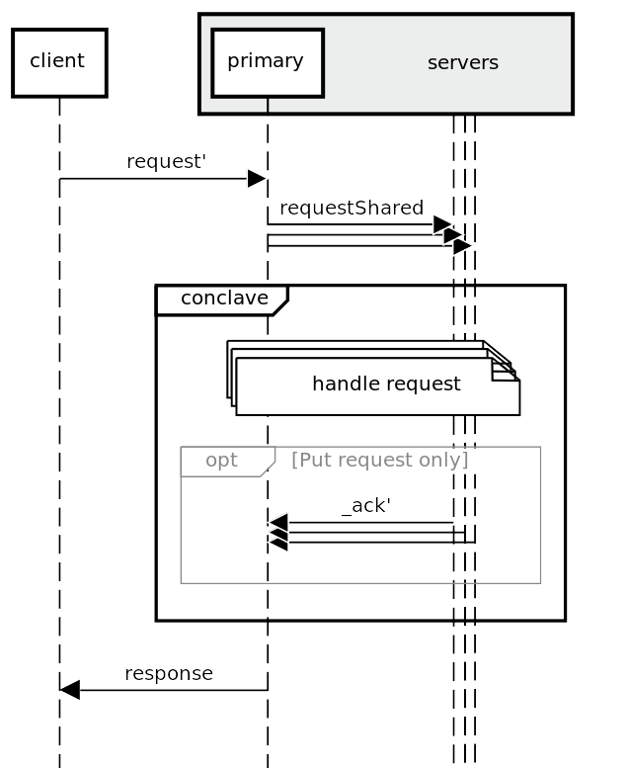
Census Polymorphism!
Write choreographies for large numbers of participants!
Write choreographies for unspecified numbers of participants!
    (all polymorphism is resolved statically)
Scatter/Gather!
Concise parallelism!
Faceted values
  They’re like MLVs, but everyone has their own value.
Quires
  Party-indexed vectors
  (similar to subjective values)
Notes:
Modern concurrent systems have dozens, in some cases thousands of participants.
Many protocols are parametric over their number of participants.
e.g. in the sequence diagam, there could be a thousand servers, or there might only be “primary”! I’ve drawn it to indicate that the quantity is unspecified, and you can write it exaclty like that in MultiChor.
- Scatter and Gather are traditional operators in parallel computing; we can do them.
- We can also do concise parallelism, like “handle requests.
- We need new data types:
- Faceted values are like MLVs, except the contents diverge.
Quires are just static vectors indexed by parties; a located quire is the opposite of a faceted.

Slide 13
Census Polymorphism!
fanIn(body : p → x @ recipients) =>
result := Quire[] @ recipients
for P in PS:
result[P] := body(P)
return result
fanOut(body : p → x @ p) =>
result := Faceted[]
for P in PS:
result[P] := body(P)
return result
scatter : Quire[recipients]@senders
→ Faceted[recipients]
gather : Faceted[senders]
→ Quire[senders]@recipients
parallel(body : p → x) =>
result := Faceted[]
for P in PS:
result[P] := locally(body(P))
return result
Faceted[PS] = { P => val_P @ P
| P ∈ PS }
Quire[PS] = { P => val_P | P ∈ PS }
Different systems will ground in different ways.
fanOut/fanIn/Faceted/Quire
scatter/gather/parallel/Faceted/Quire
Choreographies in Practice, 2016.
Luís Cruz-Filipe, Fabrizio Montesi:
  Almost a clear formalism
  Probably supposed to be fold-based
  No implementation
Notes:
This is too good to leave in Haskell!
.
To do this in your language of choice, add key operators to the choreographic API as black-boxes.
- many languages don’t have enough type-level programming for sequenceP.
- In ChoRus and ChoreoTS we hardcode “fanIn” and “fanOut”.
- FanIn’s loop body returns a located value with invariant owners; fanin wraps that up as a quire.
- FanOut is the same, but the return values are owned by the indexing parties, and get wrapped up as a faceted.
If you can’t do fanin/fanout, do more specific ops: scatter gather and parallel.
You loose flexability in these options, but you probably didn’t need it anyway.

Slide 14
Engineering an eDSL
User Software
Correctness attested by the host type system
Helper functions
λ
The Exposed API
Black-Box
Implementation
Trust us that we didn’t mess up writing this part.

Slide 15
Engineering an eDSL
User Software
Correctness attested by the host type system
Census Polymorphism
λC
The core MultiChor API
EPP as a freer monad
effect handler
Trust us that we didn’t mess up writing this part.

Slide 16
Census Polymorphism in Haskell
Modern GHC features let us write a loop function over type-level lists of locations.
We also need type-indexed vectors or dicts.
(Haskell is very good!)
sequenceP ::
forall (b :: LocTy -> Type)
(ls :: [LocTy])
(m :: Type -> Type).
(KnownSymbols ls, Monad m) =>
PIndexed ls (Compose m b) ->
m (PIndexed ls b)
sequenceP (PIndexed f) = case tySpine @ls of
TyCons -> do
b <- getCompose (f First)
PIndexed fTail <- sequenceP (PIndexed (f . Later))
let retVal :: PIndex ls b
retVal First = b
retVal (Later ltr) = fTail ltr
pure (PIndexed retVal)
TyNil -> pure ( PIndexed \case {} )
newtype PIndexed ls f = PIndexed {pindex :: PIndex ls f}
type PIndex ls f = forall l.
(KnownSymbol l) => Member l ls -> f l
6
7
18
Notes:
MultiChor gets census polymorphism for free because it’s written in Haskell.
In the sense that we could have left it out and you’d still be able to write everything yourself.
Not free in the sense that you’d have to write this stuff first.
The point isn’t to understand this code, the point is that this is a transparent type-safe helper function on top of the core API I described earlier.
.
At bottom (18): Pindexed (“Party Indexed”) is a lookup table from type-level parties to values, the types of which depend on the party in question.
SequenceP (“sequence parties) takes a Pindexed (6) who’s values all have a common monadic structure, and it sequences them together in that monad (7).

Slide 17
The superiority of sequenceP and pIndexed?
Faceted encodes shared knowledge.
Custom data types (and associated operators) are possible.
  e.g. pairwise multiply-located cross product
End-user hacking of Quire etc
  e.g. qCons
Why not foldP?
No clear path toward dynamic census polymorphism.

Slide 18
MultiChor is the best off-the-shelf implementation of CP available for real-wold use, last time I checked.

Slide 19
Engineering an eDSL
User Software
Correctness attested by the host type system
Helper functions
λ
The Exposed API
Black-Box
Implementation
Trust us that we didn’t mess up writing this part.

Slide 20
Engineering an eDSL
User Software
Correctness attested by the host type system
Exposed API
λ
Usability shim
The “Core” API
Black-Box
Implementation
Trust us that we didn’t mess up writing this part.

Slide 21
The membership system is a liability
handleRequest :: forall backups. (KnownSymbols backups) =>
Located '["primary"] Request ->
( Located '["primary"] (IORef State),
Faceted backups '[] (IORef State) ) ->
Choreo ("primary" ': backups) IO (Located '["primary"] Response)
handleRequest request (primaryStateRef, backupsStateRefs) =
broadcast (primary, request) >>= \case
Put key value -> do
oks <- parallel backups \backup un ->
handlePut (viewFacet un backup backupsStateRefs) key value
gathered <- gather backups (primary @@ nobody) oks
locally primary \un ->
if all isOk (un primary gathered)
then handlePut (un primary primaryStateRef) key value
else return errorResponse
Get key -> locally primary \un -> handleGet (un primary primaryStateRef) key
where primary :: forall ps. Member "primary" ("primary" ': ps)
primary = listedFirst
backups = consSuper refl
4
7
8
9
11
12
18
Notes:
Other than
- Intuitive and efficient KOC management
- Static checking of KOC management by the type-checker
- a recyclable embodiment of KOC as data
...What does library-level CP do for us?
.
It gives us everything the host language gives us!
.
This is real haskell using MultiChor:
- Ln 7: monadic bind, lambda case.
- Ln 8: do notation, pattern matching.
- Ln 18: quantified type variables, type-level strings
- Ln 12: clear distinction between IO and not-IO.
.
But what’s gather(ln11)? Parallel (ln9)? Faceted(ln4)?
- These are derived functions we can build on top of the core operators using Haskell. Segue!

Slide 22
congruently is a little weird
Duplicates most of the complexity of locally.
Better than naked only for subjective, Haskell-specific reasons.
Possibly the most awkward of MultiChor’s operators to formalize.
Let’s get rid of it.

Slide 23
The conclaves-only approach, approached theoretically
In a traditional lambda calculus, values are a sub-form of expressions.
T := Int | T × T | T + T | T → T
V := n | (V, V) | inL V | inR V | λx. E | x
E := V | E E | fst E | snd E | case E {…}
λ

Slide 24
The conclaves-only approach, approached theoretically
In a traditional lambda calculus, values are a sub-form of expressions.
For CP, we augment the typing context with a census and the syntax with conclave.
T := Int | T × T | T + T | T → T | Choreo p⁺ T
V := n | (V, V) | inL V | inR V | λx. E | x
E := V | E E | fst E | snd E | case E {…} | conclave p⁺ E
λ

Slide 25
The conclaves-only approach, approached theoretically
In a traditional lambda calculus, values are a sub-form of expressions.
For CP, we augment the typing context with a census and the syntax with conclave.
Additional typing and value forms for MLVs are redundant.
T := Int | T × T | T + T | T → T | Choreo p⁺ T | T@p⁺
V := n | (V, V) | inL V | inR V | λx. E | x | V@p⁺
E := V | E E | fst E | snd E | case E {…} | conclave p⁺ E
λ

Slide 26
The conclaves-only implementation: MiniChor
broadcast :: Member p ps ->
Choreo ‘[p] a -> Choreo ps a
conclave :: Subset ps qs ->
Choreo ps a -> Choreo qs (Choreo ps a)
locally :: IO a -> Choreo ‘[p] a

Slide 27
Implications of MiniChor
MLVs are a functor!
  and other type classes, in the Haskell sense.
Subjectively, conclaves CP may be a distinct paradigm of multi-party language.
  Annotates computation, not data. (Different from Chorλ, Pirouette)
  Linear, explicit communication plan. (Different from ScalaLoci)
Lazy, non-linear communication plans may be fundamental to CP.

Slide 28
MultiChor: Version 2.0
Improve documentation
Curated “medium-small” exposed API.
Use naked instead of congruently.
  Also simplifies locally.
Include class instances for Located.
Attempt (again) to replace the proof-witness system.
Tack on a failible-communication operator.

Slide 29
Future Work
A unified theory of multi-party languages
A fundamental perspective on error handling
Performance and usability measurements

Slide 30
Future Work
Thank You!
- Mako Bates
A unified theory of multi-party languages
A fundamental perspective on error handling
Performance and usability measurements

